Slide 1

Restaurant Project
Analysis
Prasang Shrivas
DS – May 2024

Slide 2

Table of Content
Introduction and Problem Statement
Market Research
Target Countries
Competitors in the Market
Financial Projections
Marketing Strategy
Competitors in the Market
Dashboard
Conclusion and key Insights

Slide 3

Introduction with Problem Statement
Zomato team wants to expand its own business, opening new restaurants in different country to capture the maximum number of customers of varying price ranges and cuisines according to country.
A dataset of the food industry(restaurants) is Analysed and insights & information are derived from the data.
The purpose of the study is to analyse the data and initially draw certain information from it.

Slide 4
Methodology
Data Cleaning
- Raw source data was cleaned for accurate analysis and to minimise errors using Excel functions like VLOOKUP, DATE, and STRING FUNCTIONS.
Data Analysis
- Cleaned data was analyzed objectively and objectively using various aggregation functions and logic to derive insights and suggestions based on the data.
Deriving Insights
- Based on the analysis, insights and conclusions were obtained for further business workup.
Further Suggestions and Operations
- Suggestions regarding further actions and advice were made for the successful establishment of the business.

Slide 5
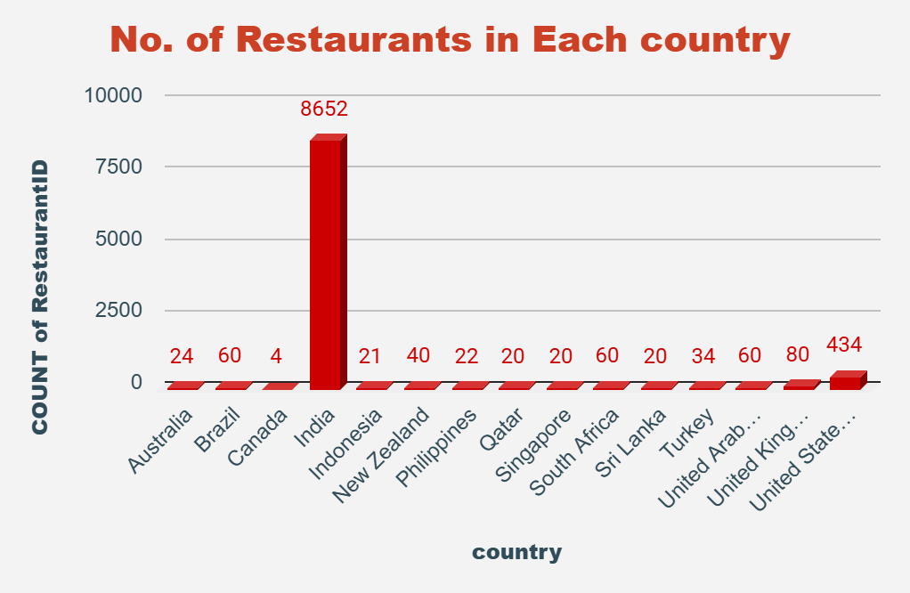
Market Research
Total Country -15
In all over world there are 9551 restaurants.
Total Number of Cuisines 1826.
Highest Number of Restaurants seen in India-8652.
Lowest Number of Restaurants seen in Canada- 4
And 388 restaurants having above than Price range 4 in India.

Slide 6
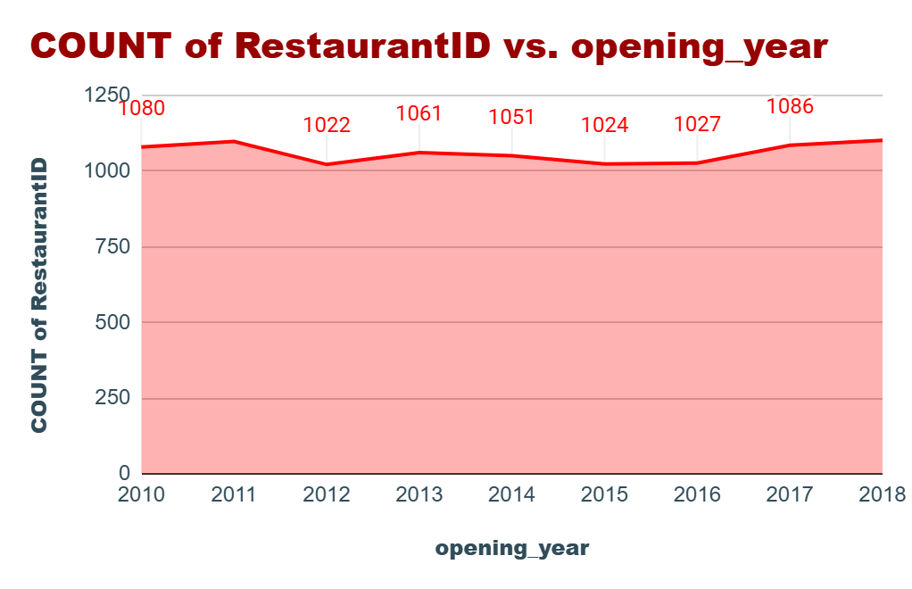
Market Research
According to our data, Every year more than 1000 restaurants are open all over the country from 2010 to 2018.
In Year 2018 had the highest opening of restaurants
There was a slowdown in openings. (2012-2016)
In Year 2012 had the lowest openings
of restaurants.
In 2010, 2011 has good number of opening restaurants.

Slide 7
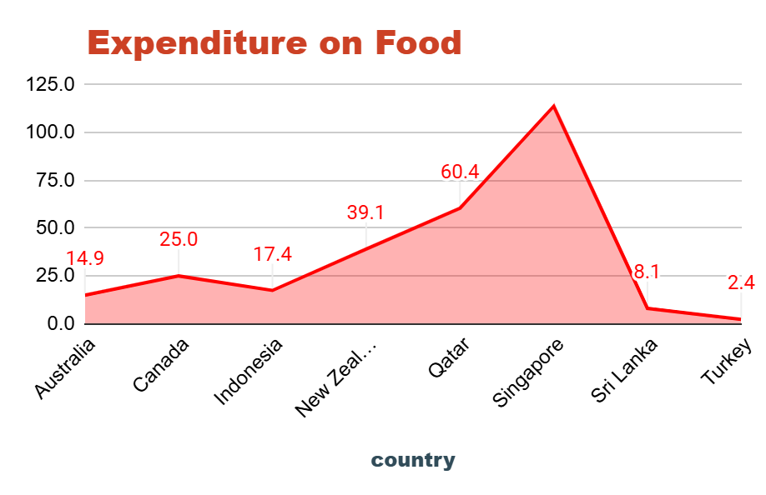
Financial projections
Country | Currency
Australia | Dollar($)
Canada | Dollar($)
Indonesia | Indonesian Rupiah(IDR)
New Zealand | Dollar($)
Philippines | Botswana Pula(P)
Qatar | Qatari Rial(QR)
Singapore | Dollar($)
Sri Lanka | Sri Lankan Rupee(LKR)
Turkey | Turkish lira
On the basis of our analysis, we can control the expenditure on food to know the average prize of two people spent on food.
So, we can serve the food under that budget.
We convert the all the country currency in US Doller.
In Turkey people need to spend $2.80 per two personal
In Singapore we need to spend $116.34 as average money for two people.

Slide 8
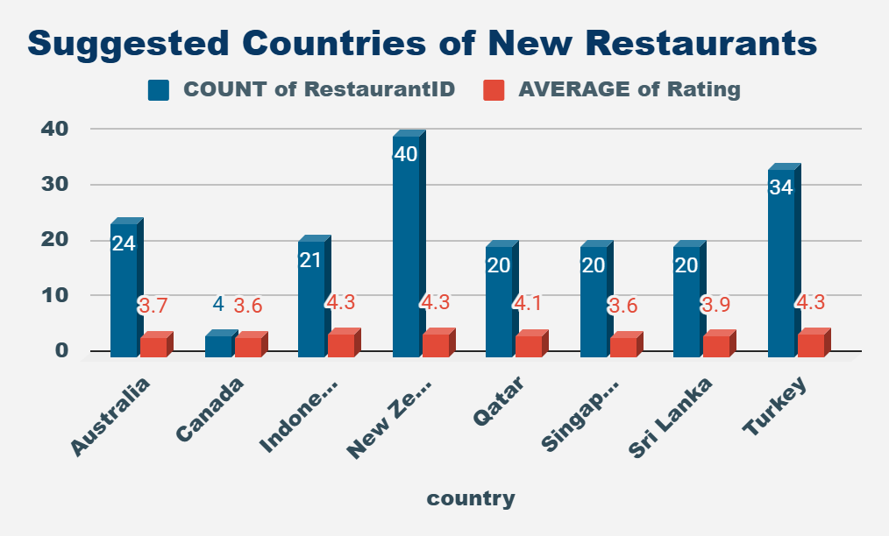
Target Countries
According to our analysis we find some country there less than 40 restaurants are opened and average rating below than 4.5.
Canada have only 4 restaurants and have only 3.6 average rating this is best country to expend business.
Qatar, Singapore, Sri Lanka have 20 restaurants with good rating, so these country have our next target.

Slide 9
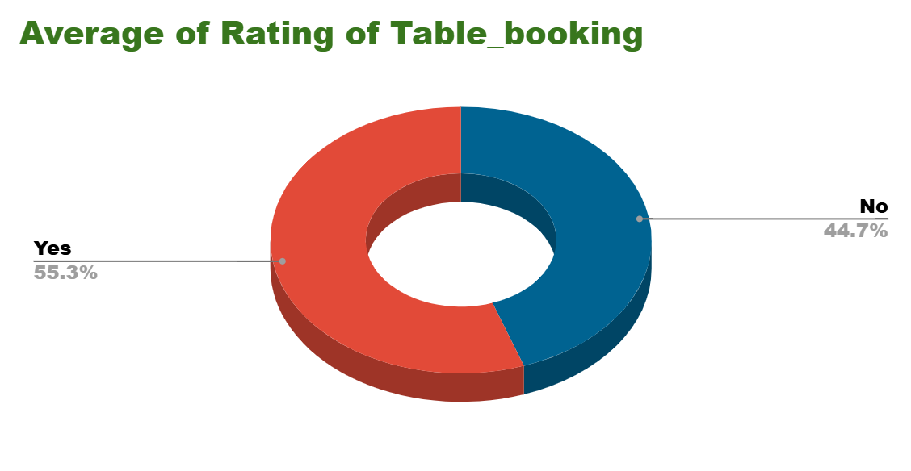
Marketing Strategy
Newer restaurants also offer the table booking option because the table booking affects the rating.
Average rating of table booking is 3.5 (55.3%).
Average rating of not booking a table is 2.8 (44.7%)
So, People want a table booking system in new restaurants and a higher rating.
It can be Concluded – Table bookings should be offered and have a direct relationship with ratings.

Slide 10
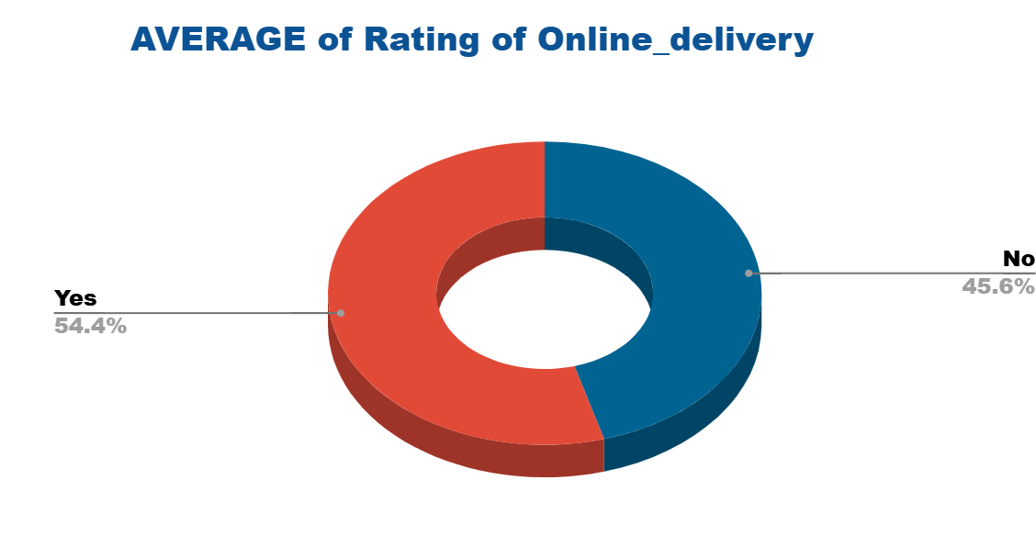
Marketing Strategy
We can also provide online delivery options because it also affects the rating of restaurants.
Average rating of Online delivery is 3.5 (54.4%).
Average rating of not having online delivery is 2.8 (45.6%)
So, People want a table booking system in new restaurants and a higher rating.
It can be Concluded – Table bookings and Online delivery should be offered and has a direct relationship with ratings.

Slide 11
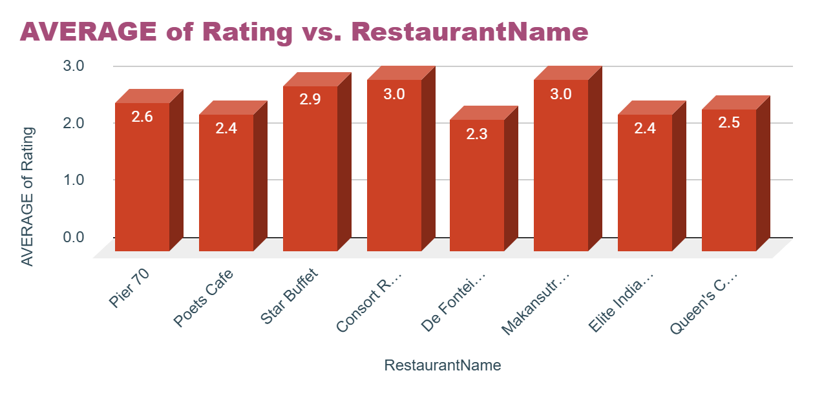
Competitors in the Market
1. There are some states where we will get a lot of competition in the market.
2. In the suggested countries there are 8 restaurants in the lower rating bracket.
3. Australia and Sri Lanka have most 3 & 2 respectively.

Slide 12
Strategy
Ratings indicate service gaps that existing restaurants fail to address, making it essential to identify these gaps.
- Services/factors identified in these gaps can be addressed through:
- **Pre-planning in hotel management**: Ensuring efficient and effective operations.
- **Advanced food production techniques**: Providing high-quality meals at minimal costs.
- This approach will attract customers by offering improved services within the same price range, capitalizing on business volume and leading to profitability.
- Additionally, logistical support and modern services like online booking, online presence, and delivery must be implemented to achieve higher ratings, increase restaurant popularity, and enhance profitability.

Slide 13
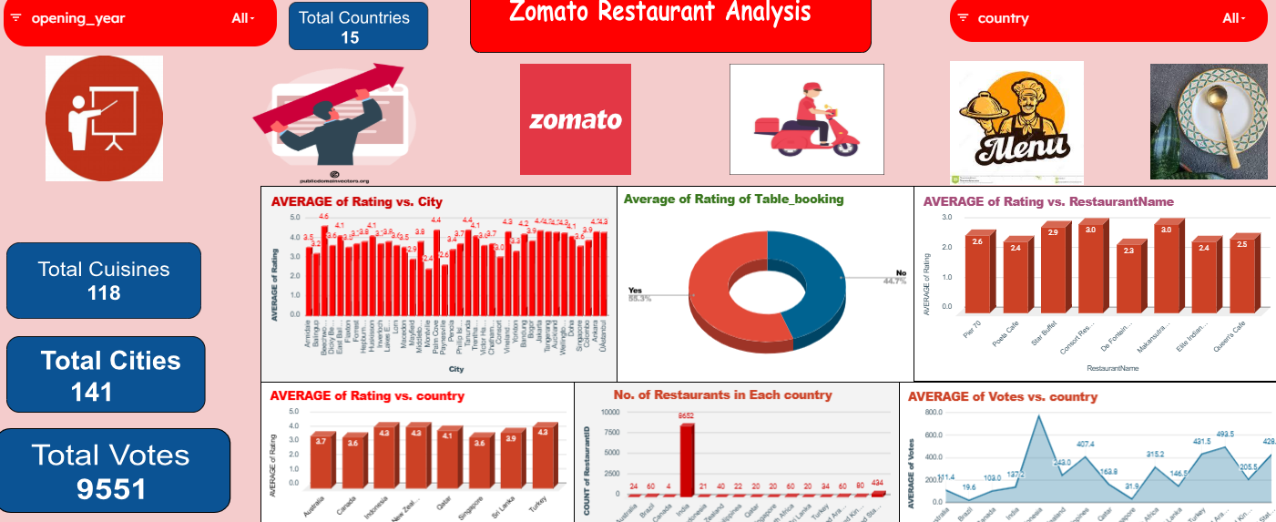
Dashboard
https://docs.google.com/spreadsheets/d/1mWYiCSp1Doy_nANdddzn2MJs5ojW-jL-FPGBP1-2Hi0/edit?usp=sharing

Slide 14

Conclusion and key Insights
Australia, Canada, Indonesia, New Zealand, Qatar, Singapore, Sri Lanka, and Turkey are the potential opportunities where the management can look to invest. As well India can be looked upon but the utmost strategy with quality concerns should exist to plan a restaurant to surpass other’s competition.
Services and quality in terms of food, ambience, and taste is more important compared to strategizing on cuisine type.
Online food delivery & table booking services have a direct effect on the ratings of a restaurant.
For the price range, with a good strategy if in a moderate price range if good services are provided still the restaurant can be profitable.

Slide 15
Thank you!!

